Slide 1
The Rank Sum Test

Slide 2
Example
New Method | Traditional Method
37 | 23
49 | 31
55 | 46
77
Name | Method | Score
Bob | Traditional | 23
Sue | Traditional | 31
Fred | New | 37
Jim | Traditional | 46
Pam | New | 49
Tim | New | 55
Zac | New | 77

Slide 3
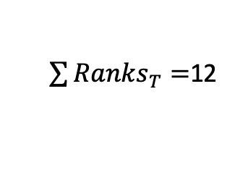
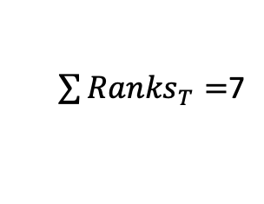
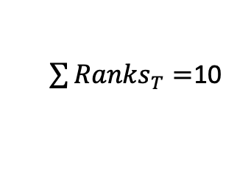
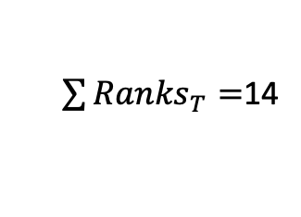
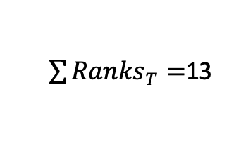
Ho: Method Does Not Effect Test Score
Observed
Name | Method | Score | Rank
Bob | T | 23 | 1
Sue | T | 31 | 2
Fred | N | 37 | 3
Jim | T | 46 | 4
Pam | N | 49 | 5
Tim | N | 55 | 6
Zac | N | 77 | 7
Name | Method
Bob | N
Sue | N
Fred | T
Jim | T
Pam | T
Tim | N
Zac | N
Score | Rank
23 | 1
31 | 2
37 | 3
46 | 4
49 | 5
55 | 6
77 | 7
Name | Method
Bob | N
Sue | N
Fred | T
Jim | T
Pam | N
Tim | T
Zac | N
Score | Rank
23 | 1
31 | 2
37 | 3
46 | 4
49 | 5
55 | 6
77 | 7
$\sum{{Ranks}_{T}}=$7
$\sum{{Ranks}_{T}}=$12
$\sum{{Ranks}_{T}}=$13
Name | Method
Bob | N
Sue | T
Fred | N
Jim | N
Pam | T
Tim | N
Zac | T
Score | Rank
23 | 1
31 | 2
37 | 3
46 | 4
49 | 5
55 | 6
77 | 7
Name | Method
Bob | T
Sue | N
Fred | T
Jim | N
Pam | N
Tim | T
Zac | N
Score | Rank
23 | 1
31 | 2
37 | 3
46 | 4
49 | 5
55 | 6
77 | 7
Name | Method
Bob | T
Sue | N
Fred | N
Jim | T
Pam | N
Tim | N
Zac | T
Score | Rank
23 | 1
31 | 2
37 | 3
46 | 4
49 | 5
55 | 6
77 | 7
$\sum{{Ranks}_{T}}=$14
$\sum{{Ranks}_{T}}=$10
$\sum{{Ranks}_{T}}=$12

Slide 4
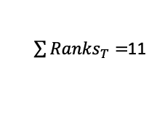
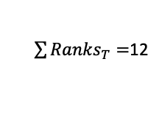
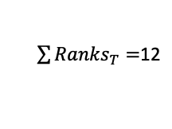
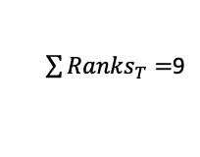
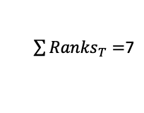
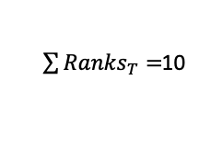
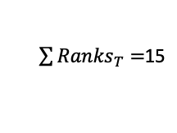
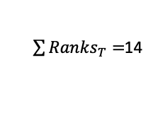
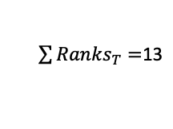
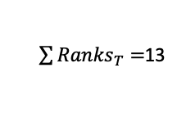
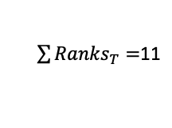
Ho: Method Does Not Effect Test Score
Observed
Name | Method | Score | Rank
Bob | T | 23 | 1
Sue | T | 31 | 2
Fred | N | 37 | 3
Jim | T | 46 | 4
Pam | N | 49 | 5
Tim | N | 55 | 6
Zac | N | 77 | 7
Name | Method | Score | Rank
Bob | N | 23 | 1
Sue | N | 31 | 2
Fred | T | 37 | 3
Jim | T | 46 | 4
Pam | T | 49 | 5
Tim | N | 55 | 6
Zac | N | 77 | 7
Name | Method | Score | Rank
Bob | N | 23 | 1
Sue | N | 31 | 2
Fred | T | 37 | 3
Jim | T | 46 | 4
Pam | N | 49 | 5
Tim | T | 55 | 6
Zac | N | 77 | 7
Name | Method | Score | Rank
Bob | N | 23 | 1
Sue | T | 31 | 2
Fred | N | 37 | 3
Jim | N | 46 | 4
Pam | T | 49 | 5
Tim | N | 55 | 6
Zac | T | 77 | 7
$\sum{{Ranks}_{T}}=$7
$\sum{{Ranks}_{T}}=$12
$\sum{{Ranks}_{T}}=$13
$\sum{{Ranks}_{T}}=$14
Name | Method | Score | Rank
Bob | T | 23 | 1
Sue | N | 31 | 2
Fred | T | 37 | 3
Jim | N | 46 | 4
Pam | N | 49 | 5
Tim | T | 55 | 6
Zac | N | 77 | 7
Name | Method | Score | Rank
Bob | T | 23 | 1
Sue | N | 31 | 2
Fred | N | 37 | 3
Jim | T | 46 | 4
Pam | N | 49 | 5
Tim | N | 55 | 6
Zac | T | 77 | 7
Name | Method | Score | Rank
Bob | N | 23 | 1
Sue | T | 31 | 2
Fred | N | 37 | 3
Jim | T | 46 | 4
Pam | N | 49 | 5
Tim | N | 55 | 6
Zac | T | 77 | 7
Name | Method | Score | Rank
Bob | N | 23 | 1
Sue | T | 31 | 2
Fred | N | 37 | 3
Jim | N | 46 | 4
Pam | N | 49 | 5
Tim | T | 55 | 6
Zac | T | 77 | 7
Score | Rank
23 | 1
31 | 2
37 | 3
46 | 4
49 | 5
55 | 6
77 | 7
$\sum{{Ranks}_{T}}=$10
$\sum{{Ranks}_{T}}=$12
$\sum{{Ranks}_{T}}=$13
$\sum{{Ranks}_{T}}=$15
Name | Method | Score | Rank
Bob | T | 23 | 1
Sue | N | 31 | 2
Fred | N | 37 | 3
Jim | T | 46 | 4
Pam | N | 49 | 5
Tim | T | 55 | 6
Zac | N | 77 | 7
Name | Method | Score | Rank
Bob | T | 23 | 1
Sue | N | 31 | 2
Fred | T | 37 | 3
Jim | N | 46 | 4
Pam | N | 49 | 5
Tim | N | 55 | 6
Zac | T | 77 | 7
Name | Method | Score | Rank
Bob | T | 23 | 1
Sue | N | 31 | 2
Fred | T | 37 | 3
Jim | N | 46 | 4
Pam | T | 49 | 5
Tim | N | 55 | 6
Zac | N | 77 | 7
Name | Method | Score | Rank
Bob | N | 23 | 1
Sue | T | 31 | 2
Fred | T | 37 | 3
Jim | N | 46 | 4
Pam | N | 49 | 5
Tim | N | 55 | 6
Zac | T | 77 | 7
Score | Rank
23 | 1
31 | 2
37 | 3
46 | 4
49 | 5
55 | 6
77 | 7
$\sum{{Ranks}_{T}}=$11
$\sum{{Ranks}_{T}}=$11
$\sum{{Ranks}_{T}}=$9
$\sum{{Ranks}_{T}}=$12

Slide 5
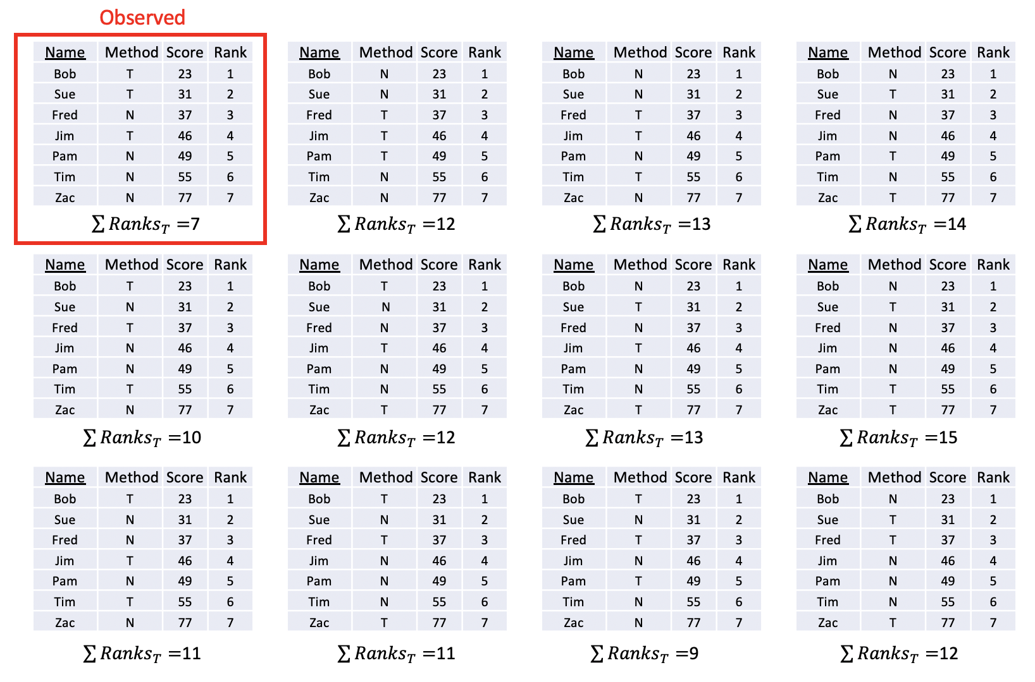
Estimation of the Distribution of the Rank Sum Statistic for n_{new} = 4 n_{trad} = 3
RankSumT = c(12,13,14,10,12,13,15,11,11,9,12)
RST = data.frame(RankSum_T = RankSumT)
RST %>% ggplot(aes(x = RankSum_T)) + geom_histogram(bins = 8, fill = "blue") + ggtitle("Estiamtiong of Distribuiton of Rank Sum Statistic for n = 7")
pvalue = 0 / 11 = .0
There is strong evidence to suggest that the median score of those that received the New method of training is different from those that received the Traditional method (pvalue = .0 from a simulation approximation of the ”exact” test.)

Slide 6
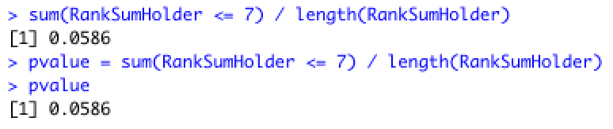
A Better Estimation of the Distribution of the Rank Sum Statistic Simulations = 10000
# New vs Traditional Go With NEW = 1
# Rank Sum Distribution
NewTrad = data.frame(Student = c("Bob","Sue", "Fred","Jim","Pam","Tim","Zac"))
NewTrad$Method = c("T","T","N","T","N","N","N")
NewTrad$Score = c(23,31,37,46,49,55,77)
simulations = 10000
RankSumHolder = numeric(simulations)
ranks = c(1,2,3,4,5,6,7)
for(i in 1:simulations)
{
#shuffle labels
relables = sample(c("Trad","Trad","Trad", "New", "New", "New", "New"),7)
# Code New = 1 and Trad = 0
relablesNum = as.numeric(relables == "Trad")
# The above code will make a vector like (1,0,1,1,0,0,1)
# Mulitply this vector times the rank vector: (1,2,3,4,5,6,7) and
# you will be left with the ranks of the New.
# The next line of code sums those ranks up. ... thus you have the sum of the ranks.
RankSumHolder[i] = sum(relablesNum*ranks)
# This code simply shoots out the first 5 permutatons and thus the first 5 sum of the ranks.
if(i < 6)
{
NewTrad2 = NewTrad
NewTrad2$Method = relables
print(NewTrad2)
print(paste("Sum of Ranks: ",RankSumHolder[i]))
}
}
# This code creates the histograms of the sum of the ranks of the many simulated experiments under Ho
hist(RankSumHolder, col = "blue", main = "Estimation of the Distribution of the Rank Sum Statistic", xlab = "Sum of the Ranks per Experiment", breaks = 40)
There is not enough evidence to suggest that the median score of those that received the New method of training is different from those that received the Traditional method (pvalue = .0586 from the ”exact” test.)

Slide 7
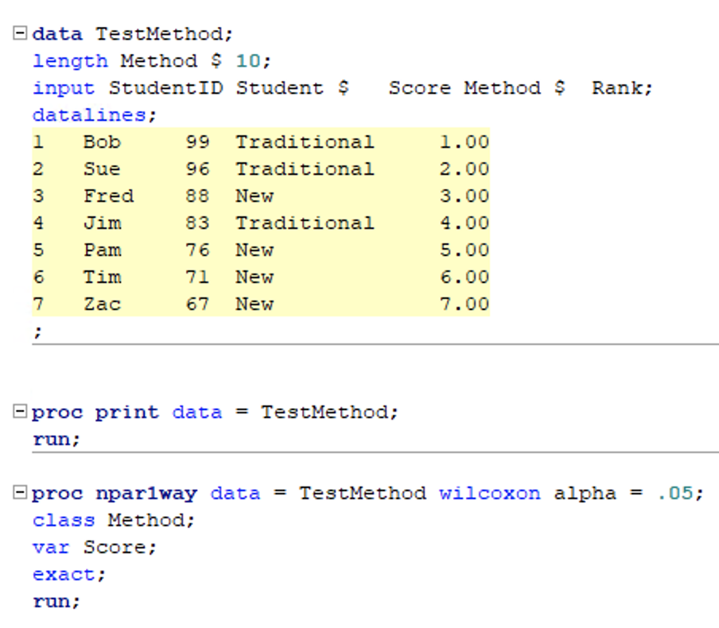
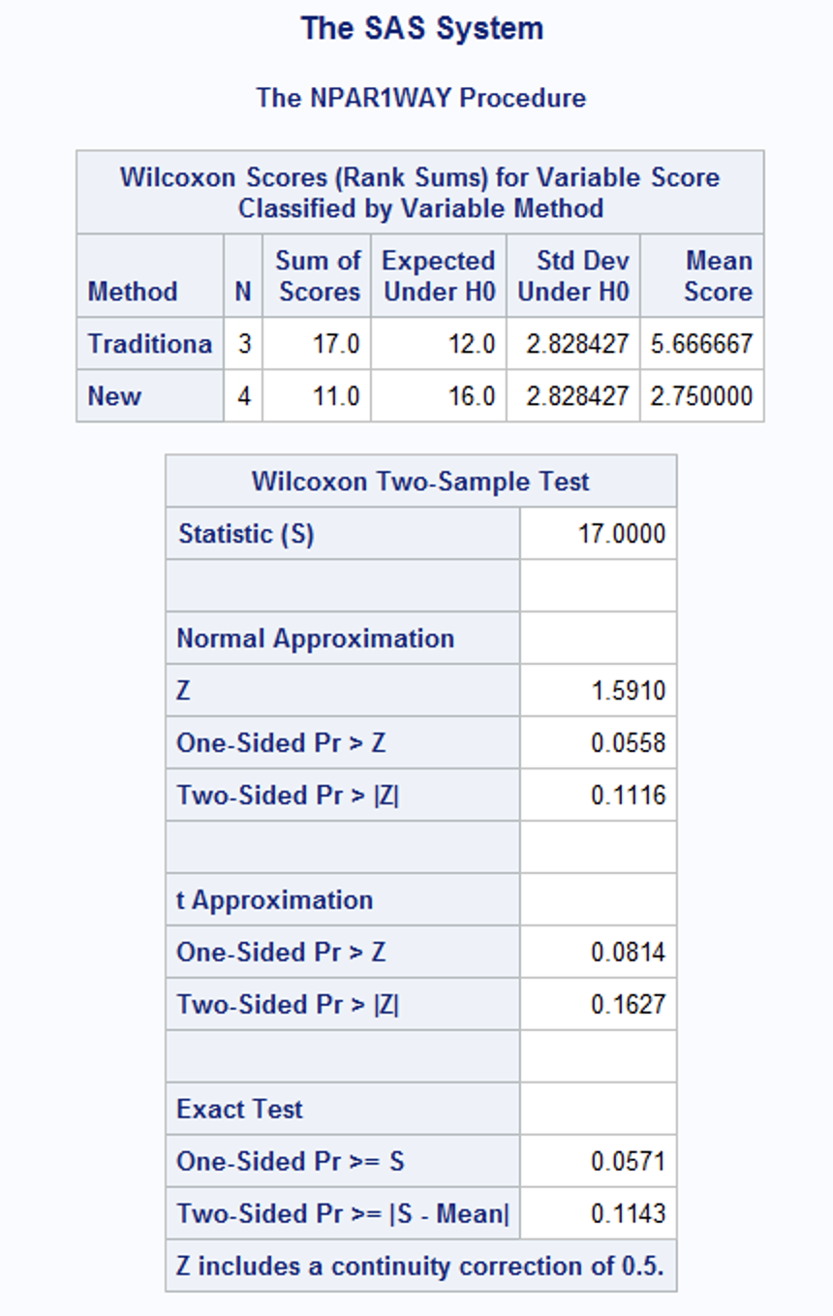
Comparing with SAS proc npar1way and “Wilcoxon”
There is not enough evidence to suggest that the median score of those that received the New method of training is different from those that received the Traditional method (pvalue = .0558 from the normal approximation of the rank sum test.)

Slide 8
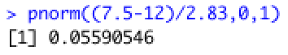
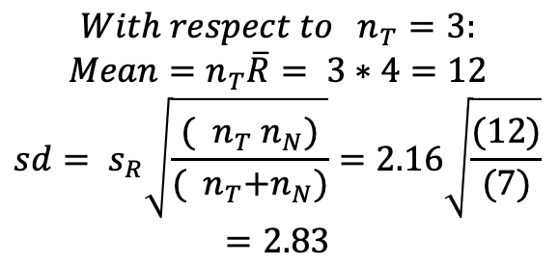
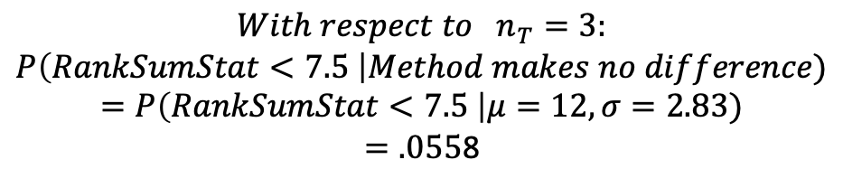
Verifying the Normal Approximation by Hand
$$With respect to { n}_{T}=3:$$
$$Mean=n_{T}\overline{R}= 3∗4=12$$
$$sd= s_{R}\sqrt{\frac{({ n}_{T}{ n}_{N})}{({ n}_{T}{+n}_{N})}}=2.16\sqrt{\frac{(12)}{(7)}}$$
$$=2.83$$
$$With respect to { n}_{T}=3:$$
$$P\left(RankSumStat<7.5 \right|Method makes no difference)$$
$$=P\left(RankSumStat<7.5 \right|μ=12,σ=2.83)$$
$=.055$8
There is not enough evidence to suggest that the median score of those that received the New method of training is different from those that received the Traditional method (pvalue = .0558 from the normal approximation of the rank sum test.)

